Slide 1





Slide 2





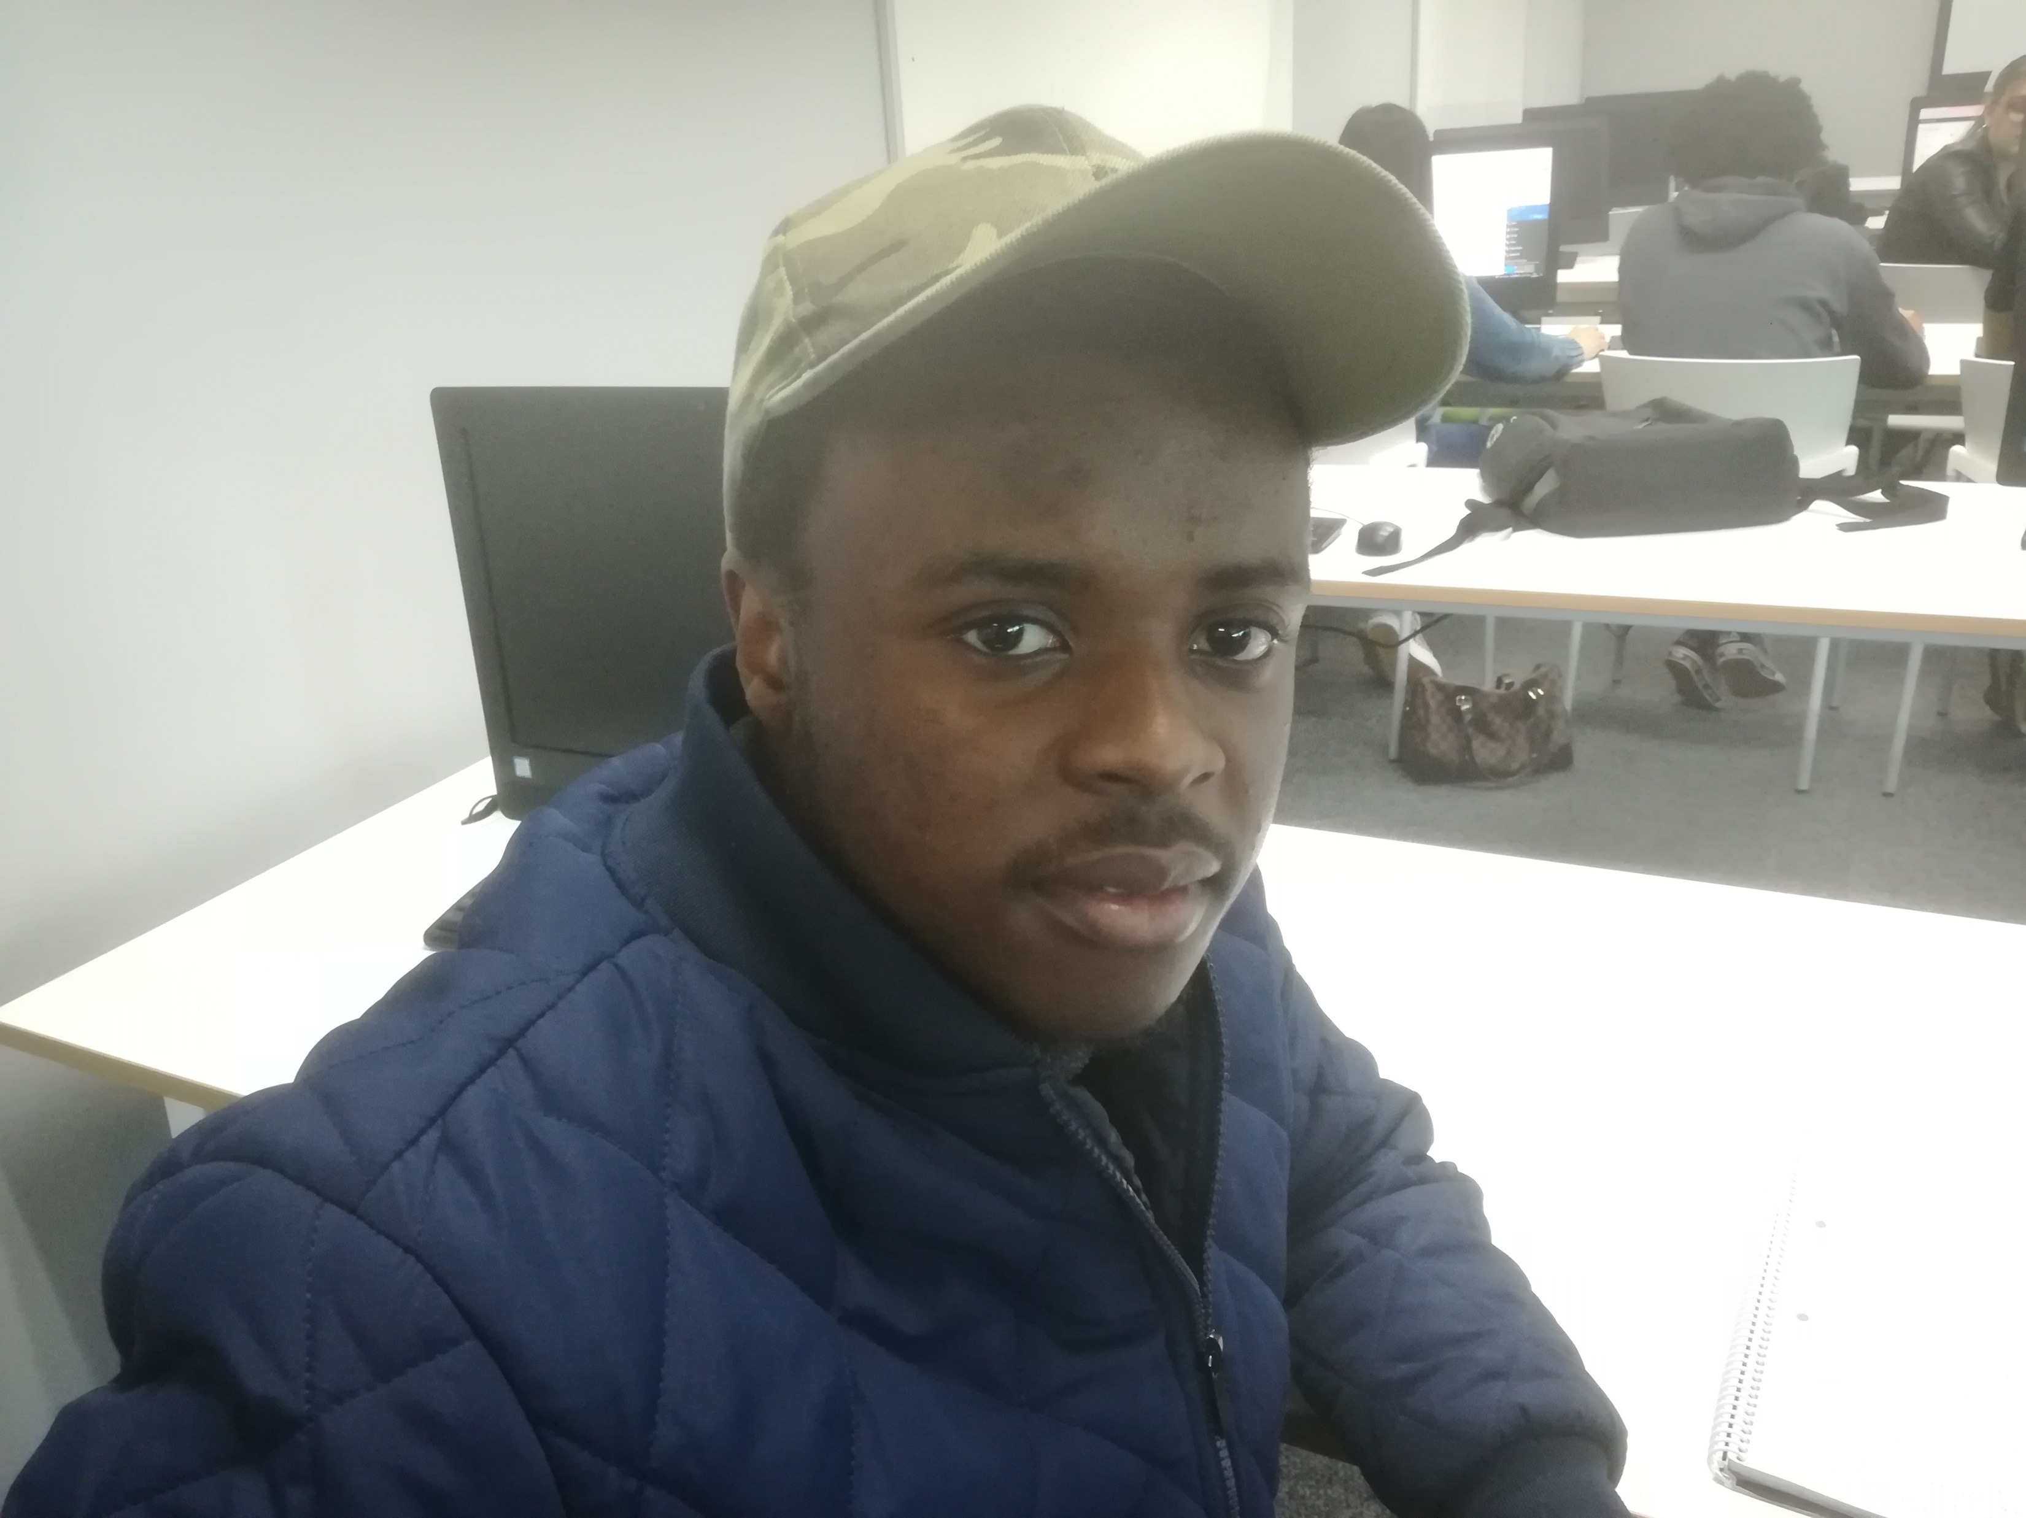
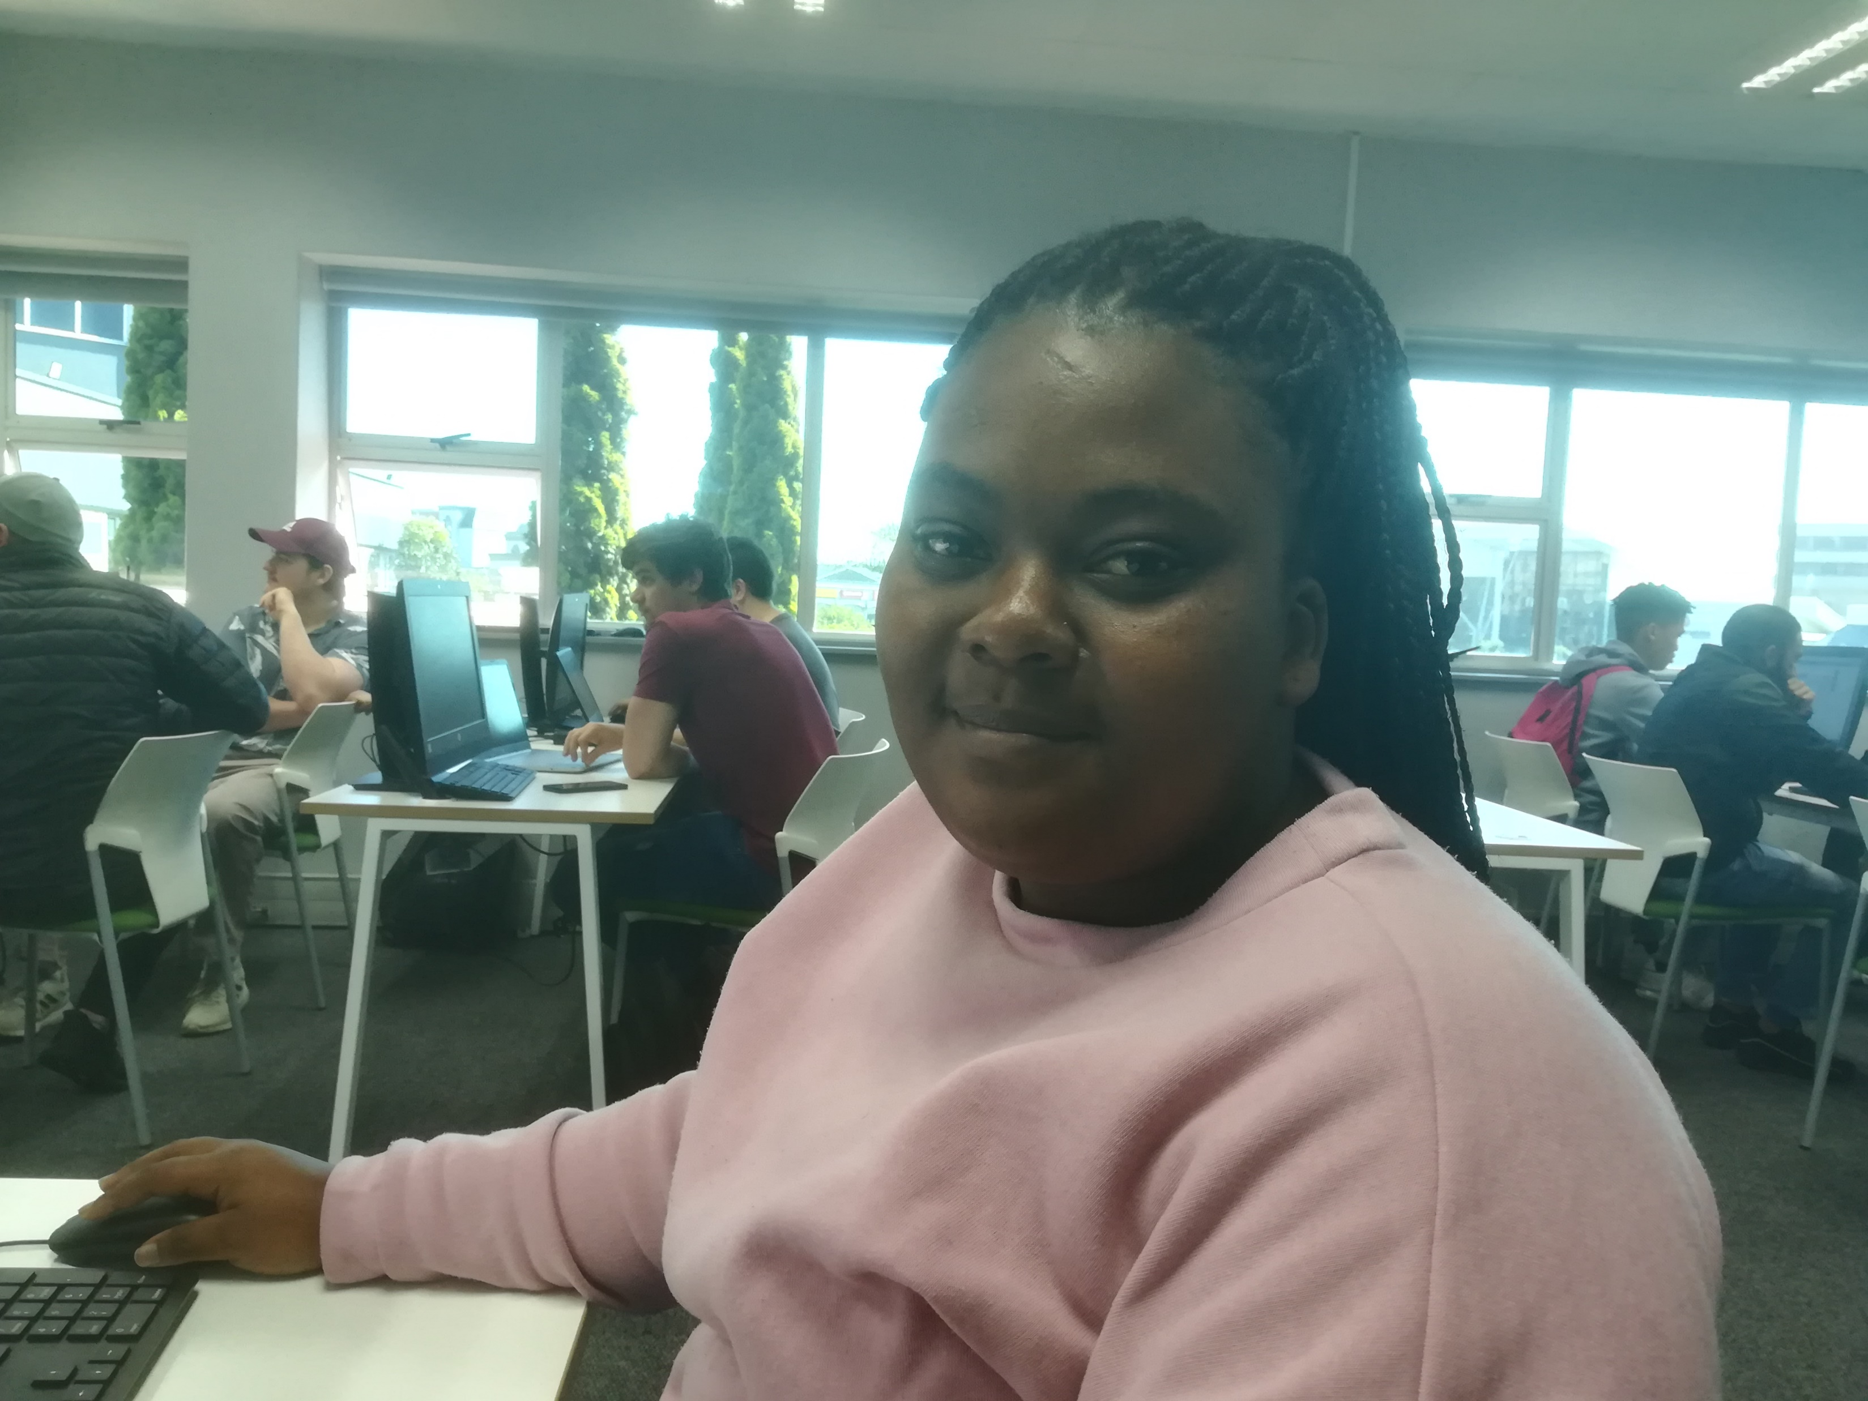
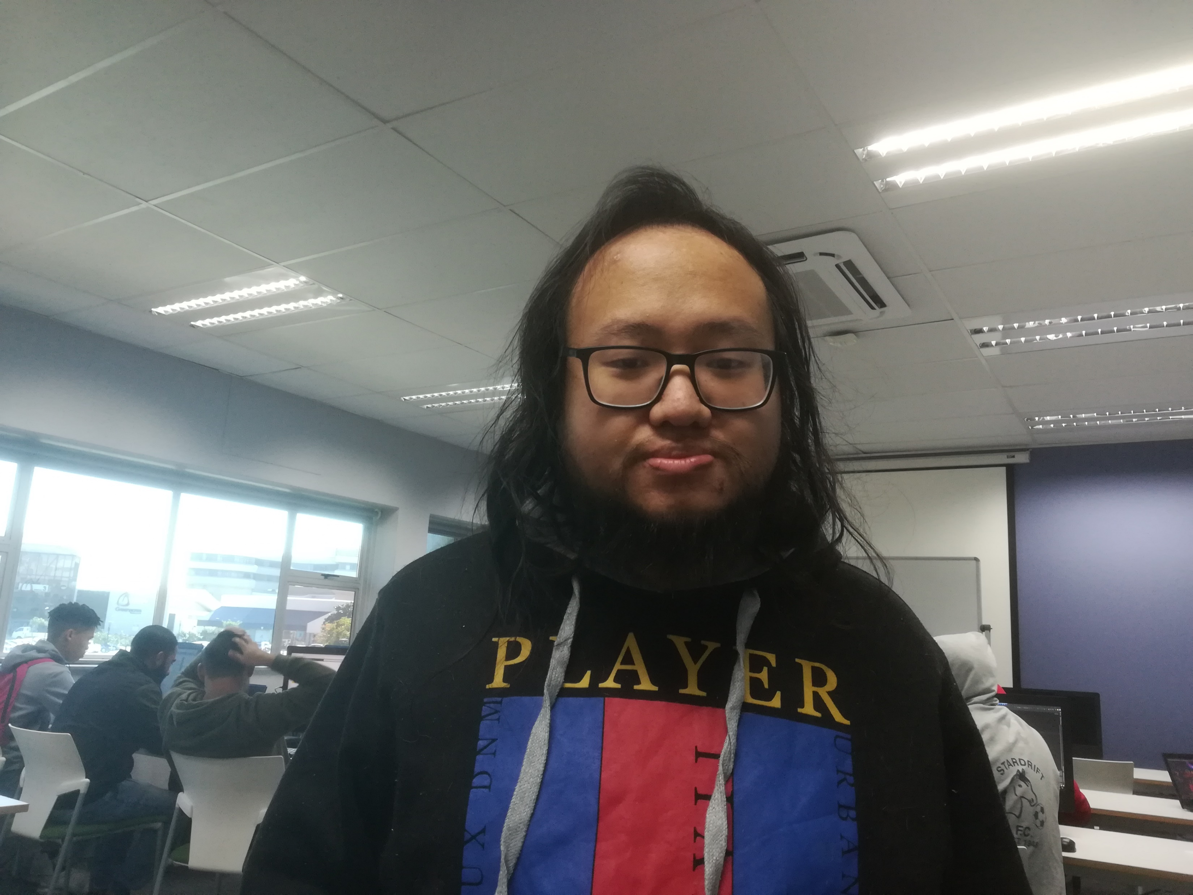
OUR MEMBERS
Magcinonke Crosby Maweyi
Aphiwe Jas
ST10117465
Raphael Son Hing
ST10117985
Introducing our team members…
ST10117427
Leader Programmer
Database Management
Assistant Programmer
Research
Schedule
Graphic Designer
Testing & Debugging
Presentation

Slide 3
INTRODUCTION
In the advent of new technology, we strive to bring to the community the advancement of convenience to our daily lives. And for those who like to explore their local domain, we, proudly introduce our newest app, Dioscuri.
With the advancements into map applications, the GPS functional app, Dioscuri, can be the light guiding one’s path through the darkness of the local community.
Named after the Greek myth, the Dioscuri, are known for guiding lost people with divine intervention, and now the manifestation of their will be incarnated with the push of a button.
So, this section our group its where they display how they plan their app to bring about how it will serve the community, the planning will be broke down into pieces so to display clear details what of features it will be carrying within itself. So, to show the clear vision that we will put in place of the app.
Who we are and our goals…

Slide 4

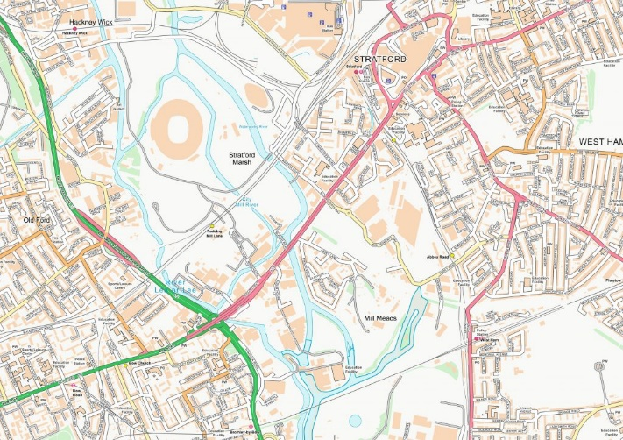

Scanning Page – there will be a page where You can scan through a barcode some maps online and download them to add them into the app on your device so that the user can have any maps, they need for travelling.
There will be an Edit Page where a map can be edited according to the expectations of the user if the user gets the knowledge that the map is inaccurate the one, they will be using currently.
They will be a download Button where the user will have options to add or download any type or form of other API that they will need to make the maps co-operate accurately while in internet connection so that the maps can easily locate any destination needed by the user.
A normal Search box will be included to the app to search locations or destinations.
A Layout Page where You can change the layout of the maps according to your own recommended way the user likes such as giving a different colouring of local landmarks or objects visible on the maps to look better for the user.
A Blog Page You to find news about the app for any latest news regarding the app or any other premium versions available about the app.
Sharing Button – you have a sharing Button where you can have options to share your location with friends on social media like Facebook, LinkedIn so that they can see your location so that it may be easy to find where the user is currently located their spot.
Update Button this button will give the user some options to update the app and also fix the co-ordinates of the app in any directions should they not be exactly accurate
Statistics Page this page will be implemented so that You can have a statistics or graph section within the app to check your progress how you used your app recently ranking with maps usage graphs.
There will be Updated Changes Page You have section within the app that shows you any changes you made to the app so that the user can know what changes they have made so that they don’t think the map was automatically updated online without their knowledge or permission.
Download Reviews You can download review reports about the app from other users online.
you can add marks to your places of interest on the map so that you can always remember them.
INNOVATIVE FEATURES
New and special features…
Geofencing this feature allows you to set up boundaries on the map for to group all specific places of interest.
Fuel saving this feature will measure the fuel on your car to see if it will be enough make it to the destination you want to head to.

Slide 5
LIST OF REQUIREMENTS
Weather forecast
The app will allow you to navigate through out the cities online to check out the weather forecast, and the app will be made to have a scale rate which it will check the weather forecast on that area and the scale on the app will suggest if the area is suitable to be headed to or not.
Good Layout Design
It’s good to have effective tools on the table before creating an app so that they bring the best design to navigate through the app easily being easy for the app to become eye-catching.
Sync Contacts
Let the app your destination so that it’s to sync your device with other phones and checking your other friends their last check-ins on social media’s like facebook, linkedin, twitter.
Gamification App
Its best to put some competition within the space of the app to win interesting prizes up for grabs so that some users would want to us the app just because of the gamification such as that.
Video Meeting
It would be also better to add some features such as allowing the user and to any of their friends to go for a video meeting to inform each other where are they.
Responsive
You can reset the size for the appearance of the app according to the user’s device and also the user has options for setting any picture mode they would like within the background of the app while using the app.
This however is an another interesting of the app, but this will however transform the app into different colours even not proffered by the user but just to fit the atmosphere of the app to make it look great because of the mode it will be used in.
Geographical
The app must be flexible to have options where you have in building maps like houses or inside a building were you can have a map but now inside a building the building or any other side becomes a map on your phone and other geographical features like wildlife reserves.
Language flexibly
If its possibly to support the app in usage in a multiple language mode, then it would be necessary to have some widgets for translation. So that people can see what they are searching in different preferred languages for themselves so that they can like the app more.
What we need to have……

Slide 6

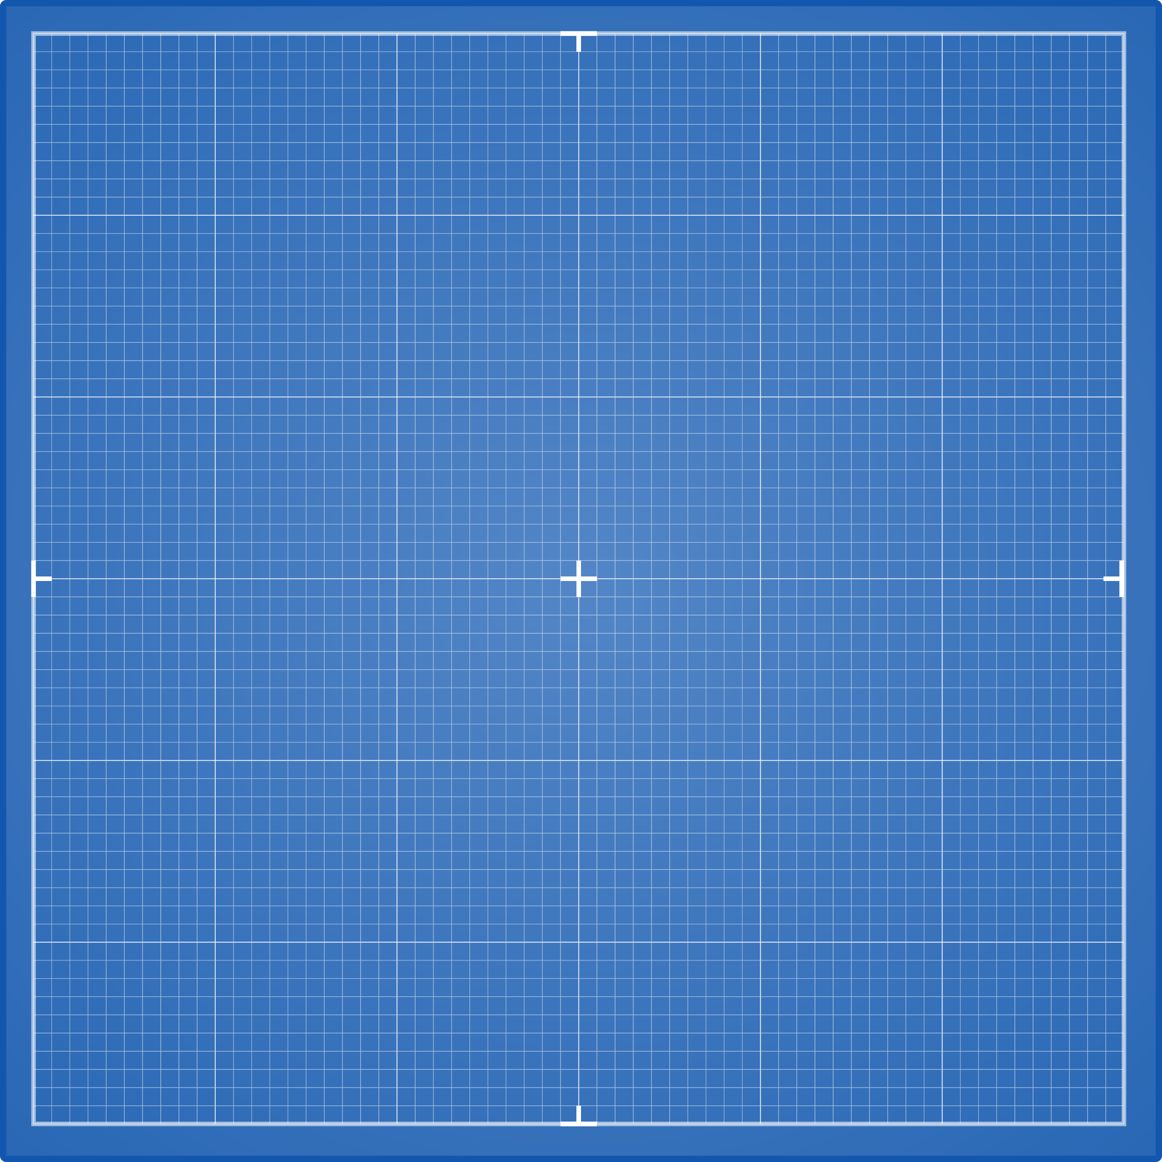

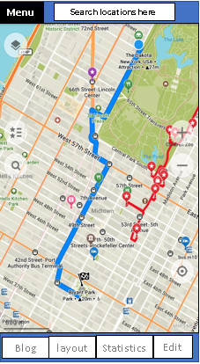
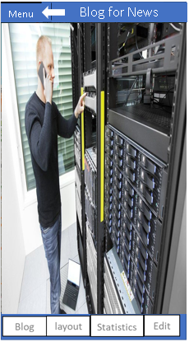
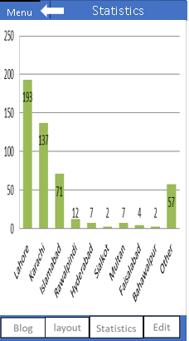
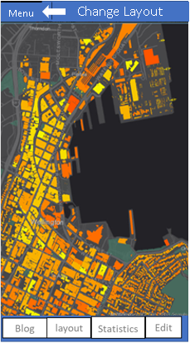
DESIGN I
Sign up – this page it’s the user will input their personal data and the system will the data into the database before they login
Login – this page is the login page where the user will login their personal data from the database then after the user will be accepted to enter the system.
Menu – this menu it’s the first page to appear after the user logs in to the system
Blog – this page is to check news
Screenshots of the app…
Designs are may be subject to change in the future…
Statistics – this page shows the user the amount of time spend using each of the maps to move around to their places of interest
Layout – this page is to change layout of the maps

Slide 7
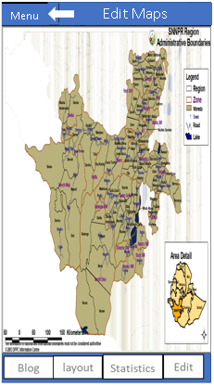
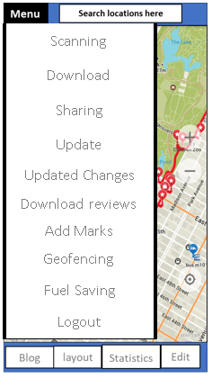
DESIGN II
Navigation menu – this is the navigation where the user can find other important pages and features the user can navigate through to any page or some listed features according to their needs or intended activities.
Designs are not final and are subject to potential change in the future…
Edit – this page is to edit maps with restructuring to the user’s recommendations.

Slide 8
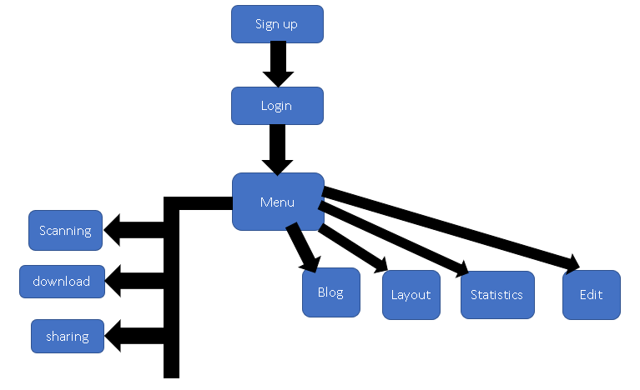
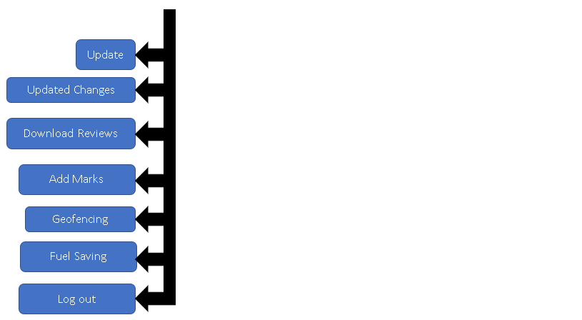
ECONOMIC FEASIBILITY ISSUES
Hoping to establish beneficial relations that can cooperate again in the future…

Slide 9
Username – Textstring.
User_password – Textstring.
Personal data of the user (UserName, UserPassword, UserEmail, profile data)
Their records of locations (distance, time, location) - textstring
Date/Time - textstring
Name of the maps - textstring
Location (City, Street, local, Landmarks) - textstring
Updating location - textstring
User Log (Last time used, how often) – textstring
DATA LISTING

Slide 10
In this section we conclude our phase for planning how to build our app named DIOSCURI It has been a tough journey where we had to specify how our app should be built according to our preferred way to serve our customers with their full expectations to be guided with a satisfying local landmark system with interesting features to navigate through including good quality gamification functions of the application.
We thank you for your learning about our demonstration and for your patience and understanding…
CONCLUSION

